Slide 1

18CSE392T – Machine Learning I
Department of Data Science and Business Systems

Slide 2
Cross validation

Slide 3
Definition
Cross-validation is a technique in which we train our model using the subset of the data-set and then evaluate using the complementary subset of the data-set.
Once we build a machine learning model, it has to be validated to ensure whether the model is working fine for the unseen data.
Helps us to predict the accuracy of our model.

Slide 4
Steps Involved
Reserve some portion of sample data set.
Using the rest data set train the model.
Test the model using the reserve portion of the data set.

Slide 5
50% - 50%
In this method, we perform training on the 50% of the given data-set and rest 50% is used for the testing purpose.
The major drawback of this method is that we perform training on the 50% of the dataset, it may possible that the remaining 50% of the data contains some important information which we are leaving while training our model i.e higher bias.

Slide 6
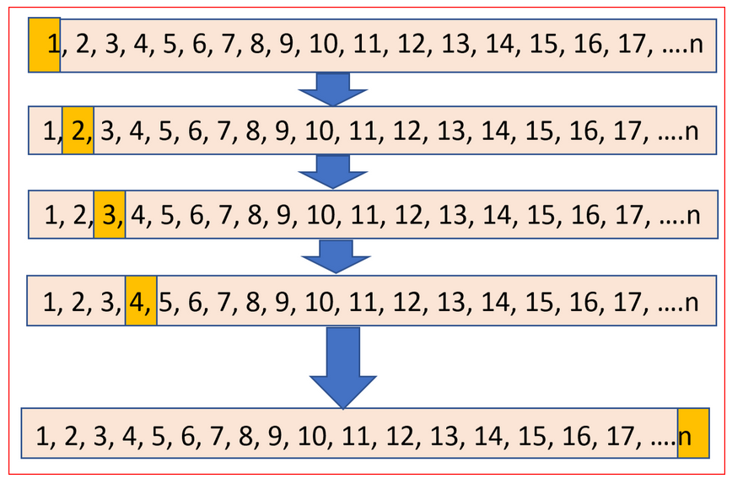
LOOCV (Leave One Out Cross Validation)
Training on the whole data-set but leaves only one data-point of the available data-set and then iterates for each data-point.

Slide 7
we make use of all data points and hence it is low bias.
Higher variation in the testing model as we are testing against one data point
Lot of execution time

Slide 8
K-Fold Cross Validation
Randomly dividing the dataset into k groups or folds of approximately equal size. The first fold is kept for testing and the model is trained on k-1 folds.
Iterate k times with a different subset reserved for testing purpose each time.

Slide 9
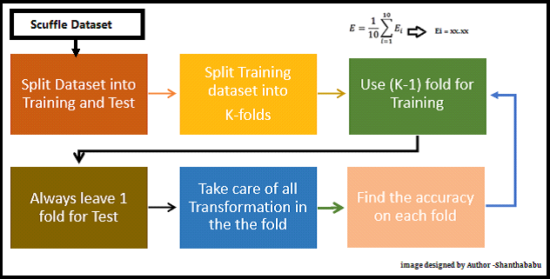
Life Cycle of K-Fold Cross-Validation

Slide 10
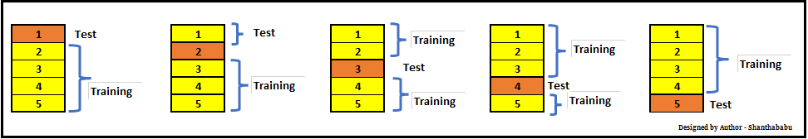
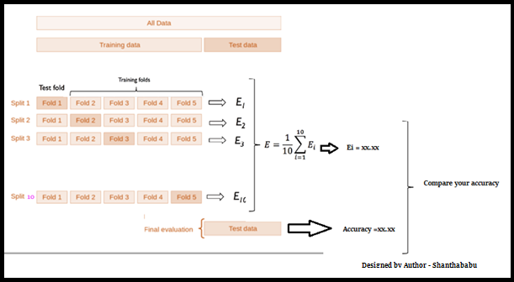
K-Fold Cross Validation for the below purpose in the ML stream.
Model selection
Parameter tuning
Feature selection

Slide 11
Computation time is reduced as we repeated the process only 10 times when the value of k is 10.
Reduced bias
Every data points get to be tested exactly once and is used in training k-1 times
The variance of the resulting estimate is reduced as k increases
The training algorithm is computationally intensive as the algorithm has to be rerun from scratch k times.

Slide 12


